Slide 1

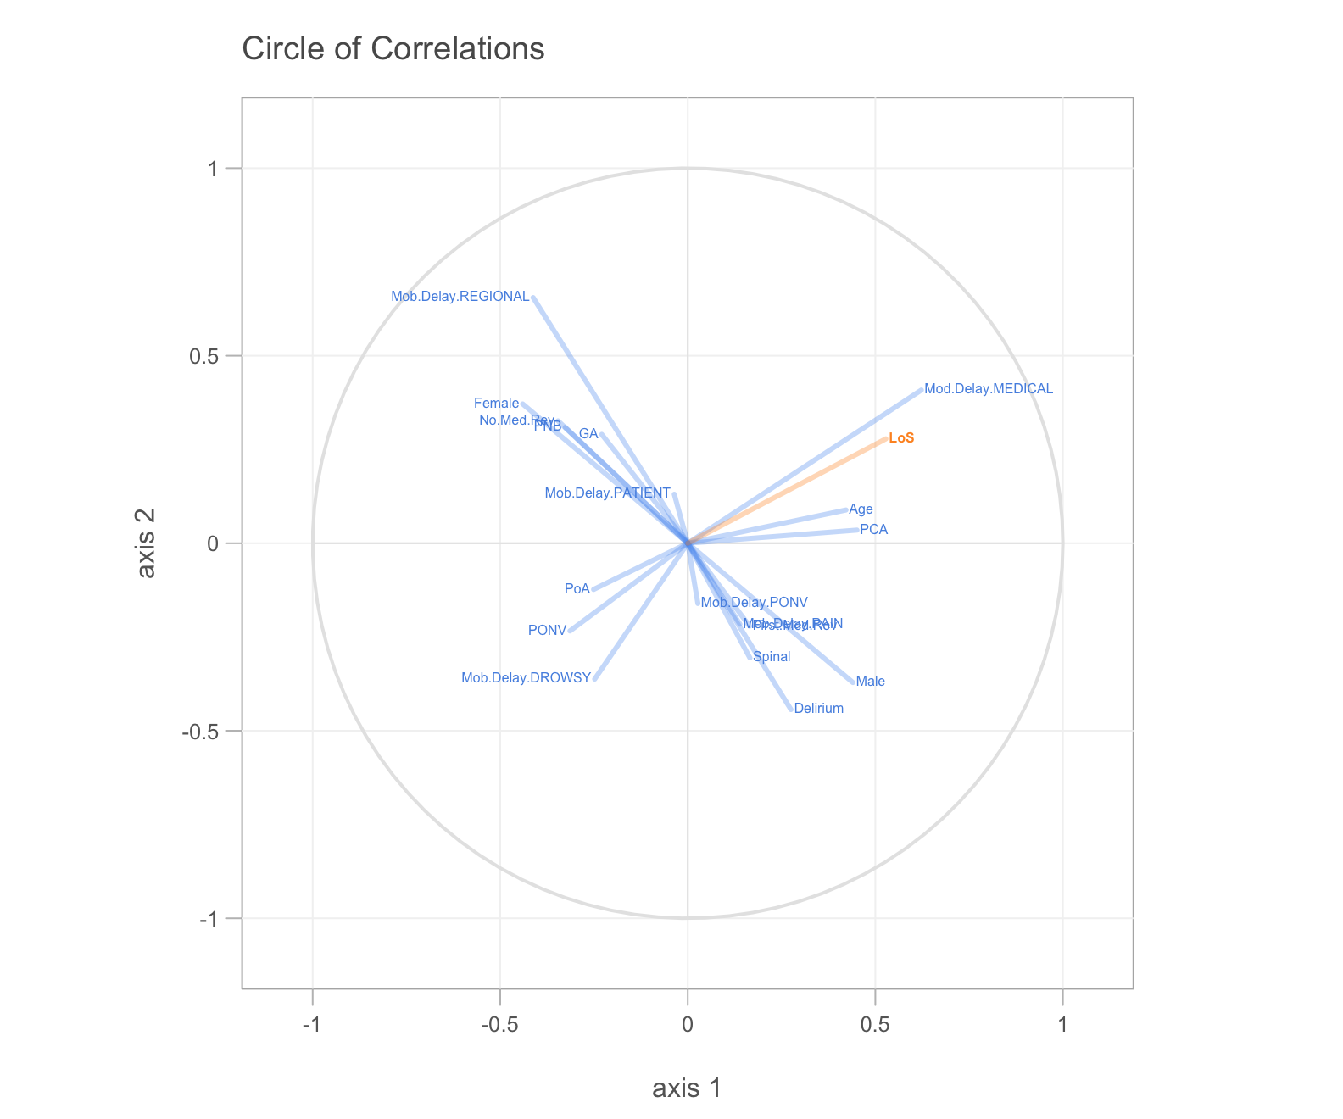
R Workshop
SMART Course 2018
Romit Samanta PhD Student, Summers Lab St7 Anaesthetics & ICM
rs307@cam.ac.uk @dr_romster

Slide 2
HEALTH WARNING

Slide 3
http://bit.do/SMART-R
Download the ‘zip’ file to the Desktop and double click on it

Slide 4
Areas to cover
R basics
Using R for your projects
Data science

Slide 5
Big Data
Automatically collected data
Data quality
‘Machine Learning’

Slide 7



Slide 8
Excel is limited
models
maths
data sizes
Nice graphs, customisable
Forgiving – tells you where the errors are
Whitespace tolerant
Web Resources
Biological-slant
Workflows

Slide 9
Alternatives
Matlab – Matrix calculations (££££)
SPSS – better GUI (££)
Python – (Free)
Graphpad PRISM – (££), no coding
Countless other

Slide 10
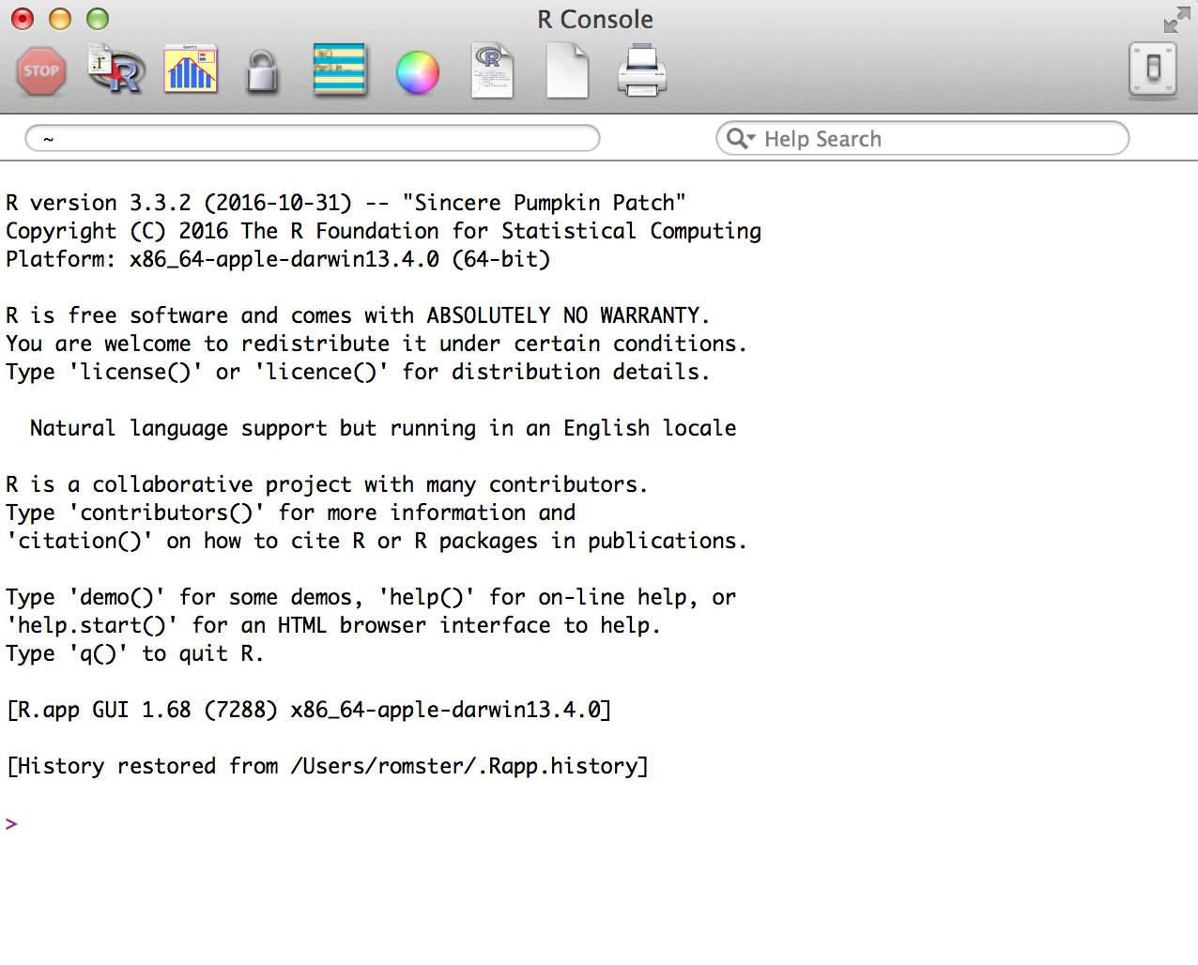

Slide 11
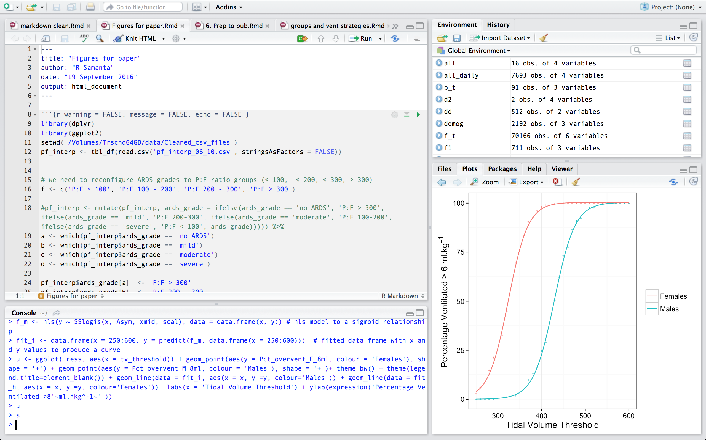
Editor
Environment
Output
Console
Notes:
Why is R good?
Excel is limited
models
maths
data sizes
Much faster
Nice graphs, customisable
Forgiving – tells you where the errors are
Web Resources
Biological-slant
Workflows
Alternatives
Matlab – Matrix calculations
SPSS – better GUI
Pyhton – ‘ the future’ of entry level
Problems
Need to do some coding and understand some basic level computer programming terms
variable, data frame, function, factor
Doesn’t interface too well with other languages (perhaps with the exception of C++ and SQL)

Slide 12
OUTPUT
3rd Party
Libraries
R Studio
User content
R
S3 / S4 / C
Machine Code

Slide 13
Variables store and allow us to access information that we assign to them
Variables can contain:
Numbers (integers or decimals)
Text (strings which are contained in “ ” or ‘ ’)
Combinations of both

Slide 14
To create a variable all we have to do is assign something to it
Assignment is done with either <- or =
Whenever we ‘call’ or reference the variable the computer will recall the value(s) contained
a
a <- 1
b <- “Male”
b
##[1] “Male”

Slide 15
Variable names can be any text but don’t use spaces or special characters [ ^*%$@#! |~]
They are case sensitive
You can use _ or .
bad code <- ‘me’ X
better_code <- ‘you’ OK

Slide 16
Adding more values to a variable is called concatention ( combining ) and is done in R with
c ( bits, to, be, joined, up, separated, by, commas )
number <- c ( 1, 2, 3, 4 )
sex <- c ( “Male”, “Female” )

Slide 17
R notation
Variable / Vector
Assignment ‘ <- ‘ or ‘ = ‘
Text, numbers, categories
Text is often referred to as strings and must be entered within “ ” or ‘ ‘
Calling a variable
Mathematical operators: * / + -
Logical operators: == & | > < >= <=
Absent values: NA NULL
Concatenate: c ( )
a
a <- 1
b <- “Male”
b
##[1] “Male”
b <- c(“Male”, “Female”)
d <- c(0,1,2,3,5,8,13,21)

Slide 18
Exercise 1

Slide 19

Open R Studio
Create a new script [hint: ]
Create a variable ‘a’ consisting of text strings:
John, Paul, George, Ringo

Slide 20
Create a vector ‘b’ consisting of the numbers:
200, 515, 180 , 160
Divide every component of b by 2

Slide 21
Exercise 2

Slide 22
R Notation
Data frame
Data table consisting of row / columns
Selecting rows or columns
e[ row #, column # ] vs
e$column_name
Selecting individual elements
e[[ ]]
e <- data.frame(a,b)
?data.frame()
e[1,]
e[,1]
e$a
e[[2]]

Slide 23
Combine the elements a and b into a data frame e using the data.frame( ) function
Call e

Slide 24
Data Frame
Selecting the correct data
e [ rows, columns ]
e [ 1, ]
e [ , 1]
e [1,1]

Slide 25
Data Frame
Naming columns and rows
colnames ( dataframe ) <- c( “text1”, “text2” )
colnames (e) <- c(‘Beatle’, ‘worth’)
Once a column is named we can access it using ‘$’
e$Beatle
e$worth

Slide 26
R Notation
Functions
In built (or user created code) that take
Inputs
Arguments
Generates an output
c ( )
plot ( )
data.frame ( )
?function_name
Notes:
Case sensitive, white space blind

Slide 27
Exercise 3

Slide 28
Anatomy of a function
x <- seq(0, 50, 5)
y <- seq(0, 200, 20)
plot ( x , y, xlab = ‘Time’ )
y2 <- seq(0 ,100, 10)
Function Name
Input variable(s)
Argument(s)
points(x, y2, col = ‘red’)

Slide 29
Exercise 4

Slide 30
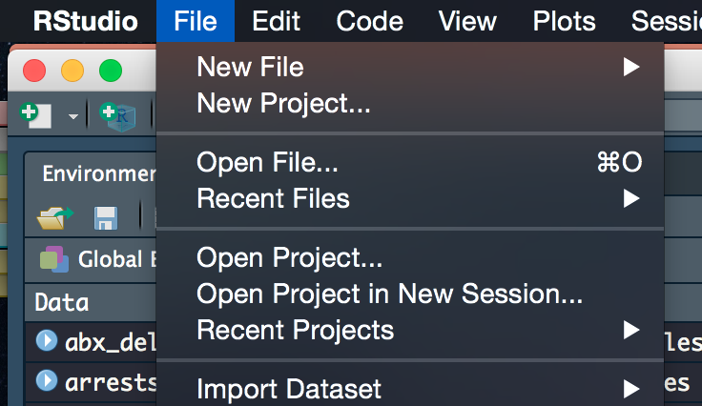
In R Studio:
File menu…
Open File…
Desktop → qicharts2_wrkshp
→ qicharts2_wrkshp.Rdata
or in R Studio type:
load("C:/Desktop/qicharts2_wrkshp/qicharts2_wrkshp.Rdata")

Slide 31
Load the qicharts2 package
library(qicharts2)
Open the qicharts2_problems.R file (in R Studio)

Slide 32
Exercise 5

Slide 33
Importing Data
CSV file
Tell R where to find the file
Import
dataFrame.Name <- read.csv (“abc.csv“, header = TRUE)

Slide 34
Import the data.csv file to a data frame called vent.data
Import the demographics.csv file to a data frame called demographics

Slide 35
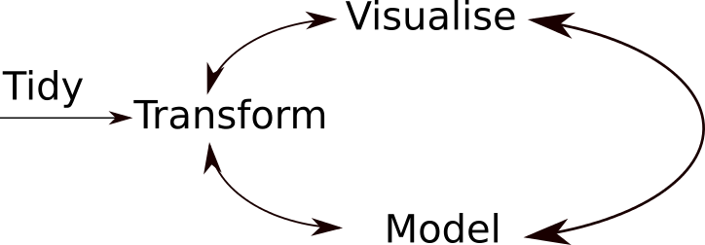

Slide 36
Getting to Know Your Data
Call the dataframe
head( dataFrame.name )
tail (dataFrame.name, 10)
summary (dataFrame.name)

Slide 37
Merging Data Frames
Frequently required
unique(vent.data[1,])
unique(demographics$Hospital_no)
length(unique(vent.data[1,]))
length(unique(demographics$Hospital_no))

Slide 38
Merging Data Frames
Easier if we merge on a common term
colnames(vent.data)[1]<- “Hospital_No”
head(vent.data)
all.vent.data <-
merge(vent.data, demographics, by.demographics=“Hospital_No”)
head(all.vent.data)

Slide 39
Recap
You now know the terms:
Variable
String
Data frame
Concatenate
Function
Argument
Slice

Slide 40
Recap
You can:
Assign variables
Manipulate variables with functions and mathematical operators
Combine variables with data frames
Select / slice data frames
Rename data frame columns
Import data from .csv files

Slide 41
Indexing
Allows tracking of groups of data within data frames and makes loops and plots much easier
Create a new column (index) which will be a numerical equivalent of each unique hospital number.
R needs to be told each hospital no is a unique category (factor)

Slide 42
Indexing
vent.data$index <-
as.integer( factor( vent.data[ , 1],
levels = unique( vent.data[ , 1] ) ) )
head(vent.data)
tail(vent.data)

Slide 43
Indexing
Remerge like we did before
all.vent.data <- merge(
vent.data, demographics, by.demographcs='Hospital_No')
head(all.vent.data)
Then reorder using the order( ) function
all.vent.data <- all.vent.data[order( all.vent.data$index), ]
head(all.vent.data)

Slide 45
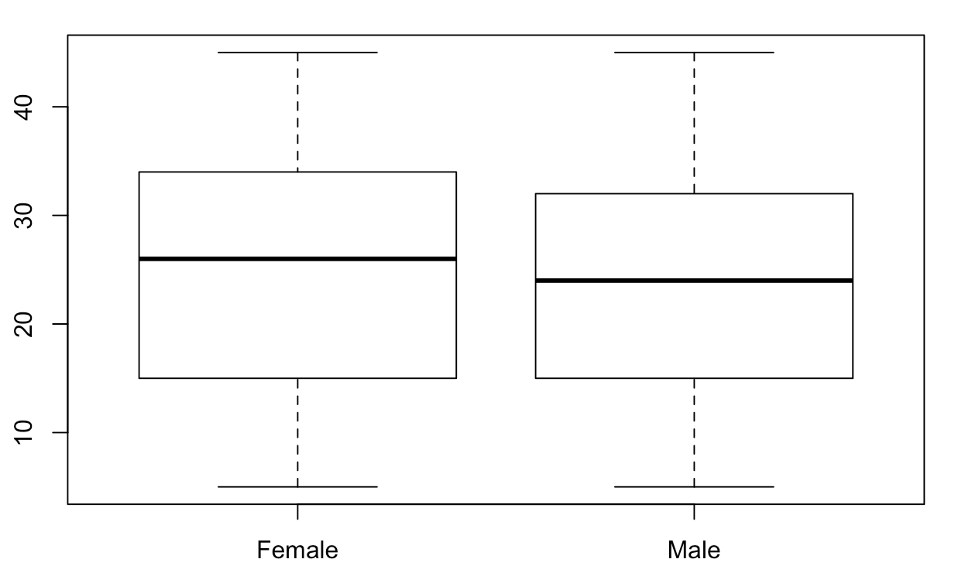
Visualising Data
Factors allow simple categorical data to visualised easily
boxplot(all.vent.data$PlateauPress ~ all.vent.data$Sex)

Slide 46
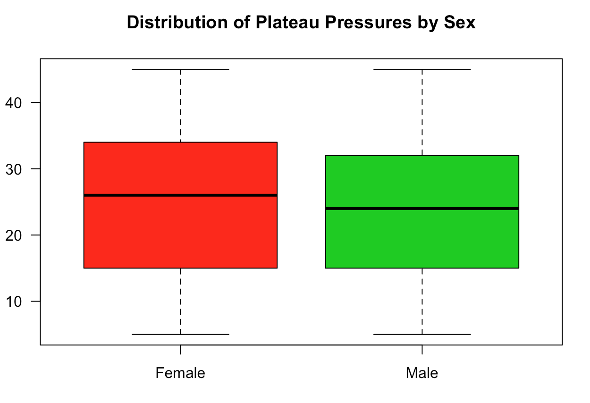
Visualising Data
boxplot(all.vent.data$PlateauPress ~ all.vent.data $Sex, col = c(2,3), main = 'Distribution of Plateau Pressures by Sex', ylab = 'Plateau Pressure (cmH2O)', las = 1)

Slide 47
Slicing
If we want to just look at one patient we can use the subset ( ) command
This looks at portion of a data frame which satisfies some logical condition
subset ( df$column wanted , logical condition to be met )

Slide 48
Slicing
x <- subset(all.vent.data$Ventilator.hour, all.vent.data$index == 1)
y <- subset(all.vent.data$PlateauPress.cmH20, all.vent.data$index == 1)
plot ( x, y ) or plot ( y ~ x )

Slide 49
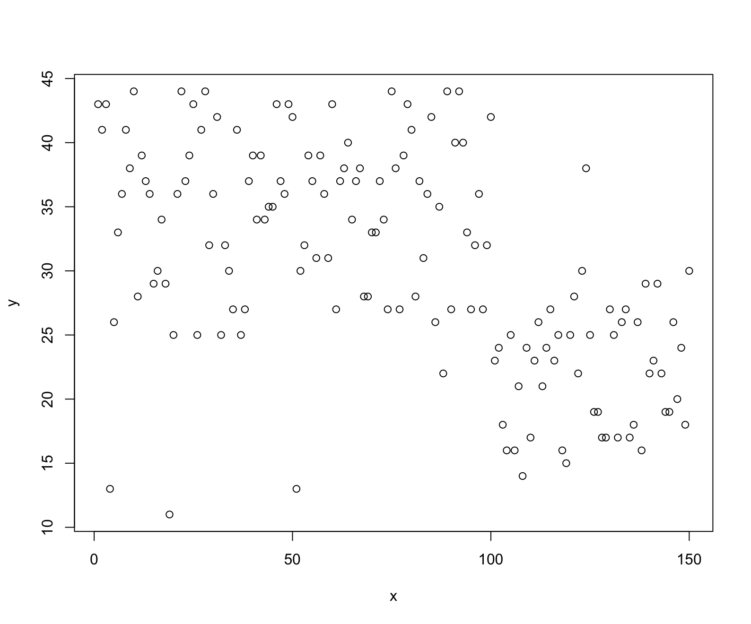

Slide 50
Make it look better
plot(y ~ x, xlab= 'Ventilation Duration (hours)', ylab = 'Peak pressure (cmH20)', main = 'Plateau pressures Over Time for Patient Index 1', pch= 19, cex = 0.7, las = 1, col = 'red3')

Slide 51
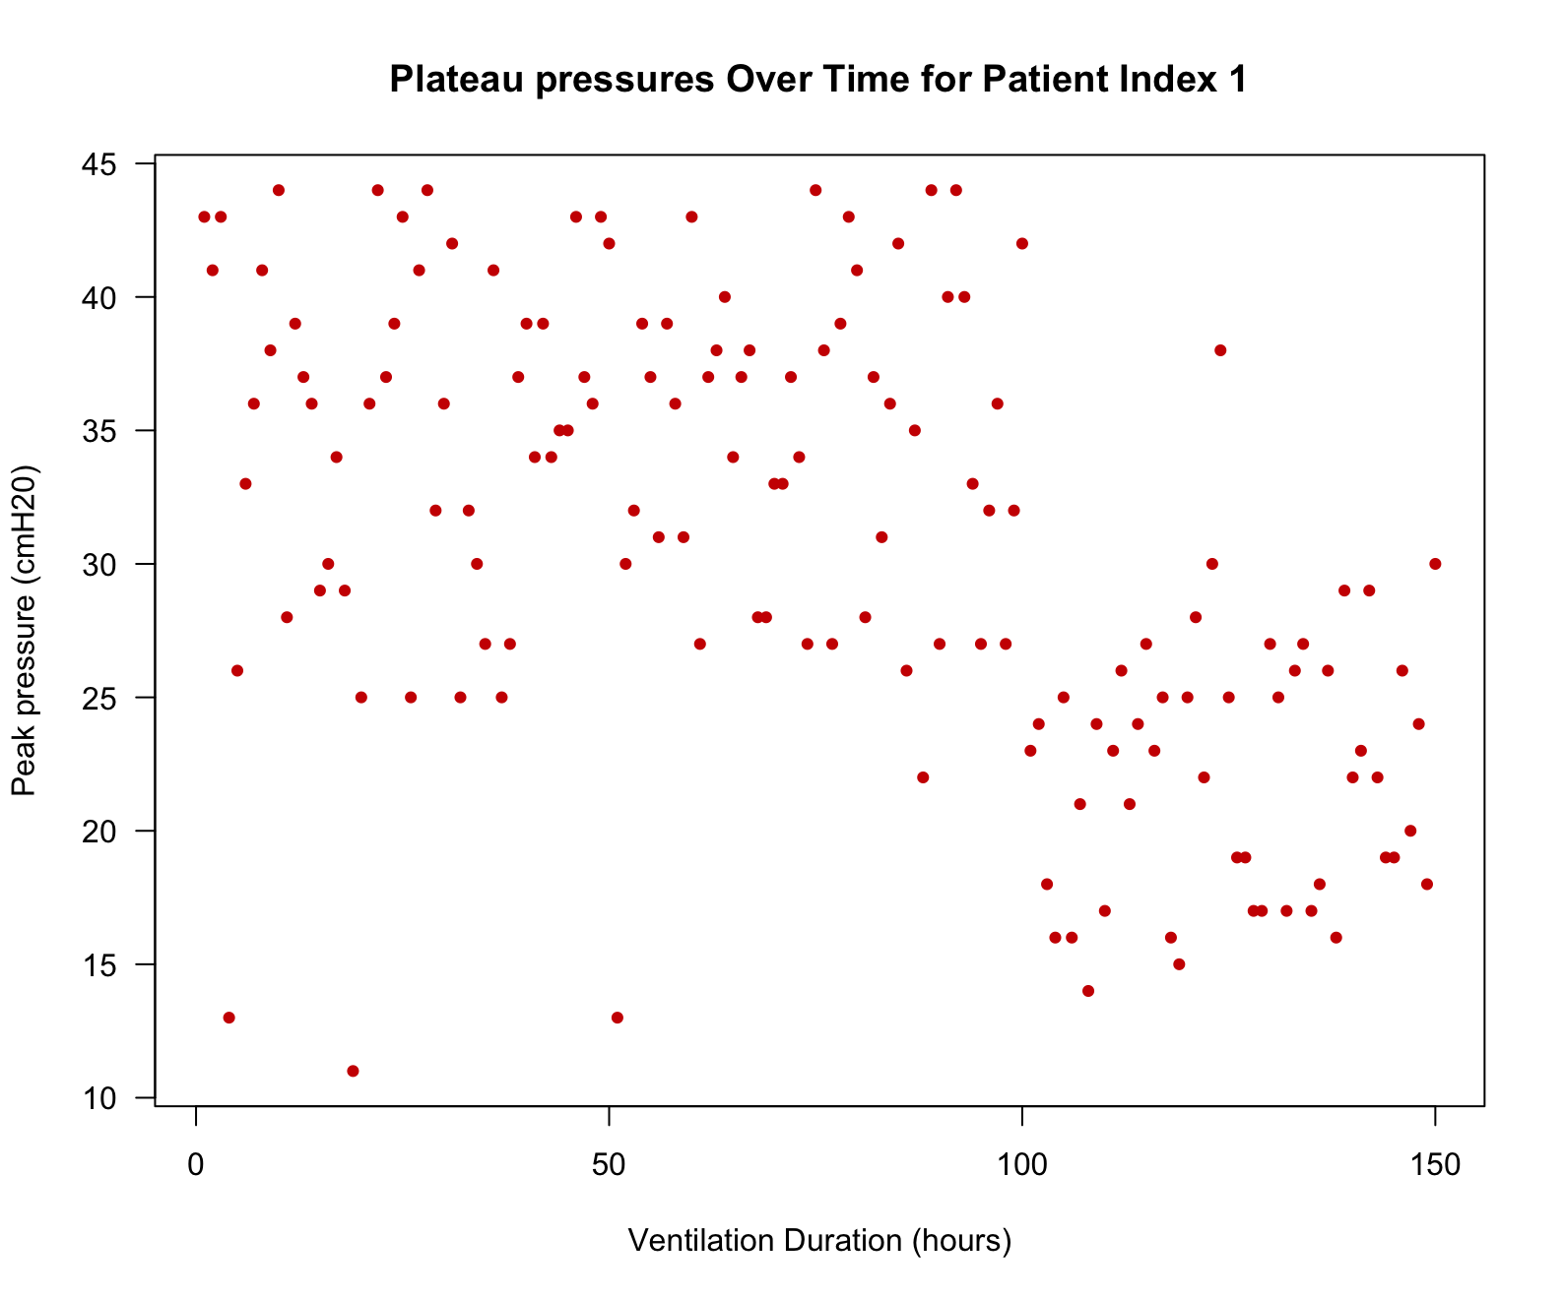

Slide 52
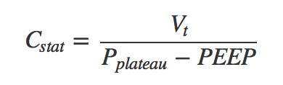
Analysis
all.vent.data$Cstat <- all.vent.data$TidalVol.ml / ( all.vent.data$PlateauPress.cmH20 – all.vent.data$PEEP.cmH20 )
attach(all.vent.data)
all.vent.data$Cstat <- tidal_vol.ml / (PlateauPress.cmH20 – PEEP.cmH2O)
detach(all.vent.data)

Slide 53
Analysis
Visualise! Visualise! Visualise! Visualise!
summary(all.vent.data)
What’s the problem?
hist(all.vent.data$Cstat, breaks = 100)

Slide 54
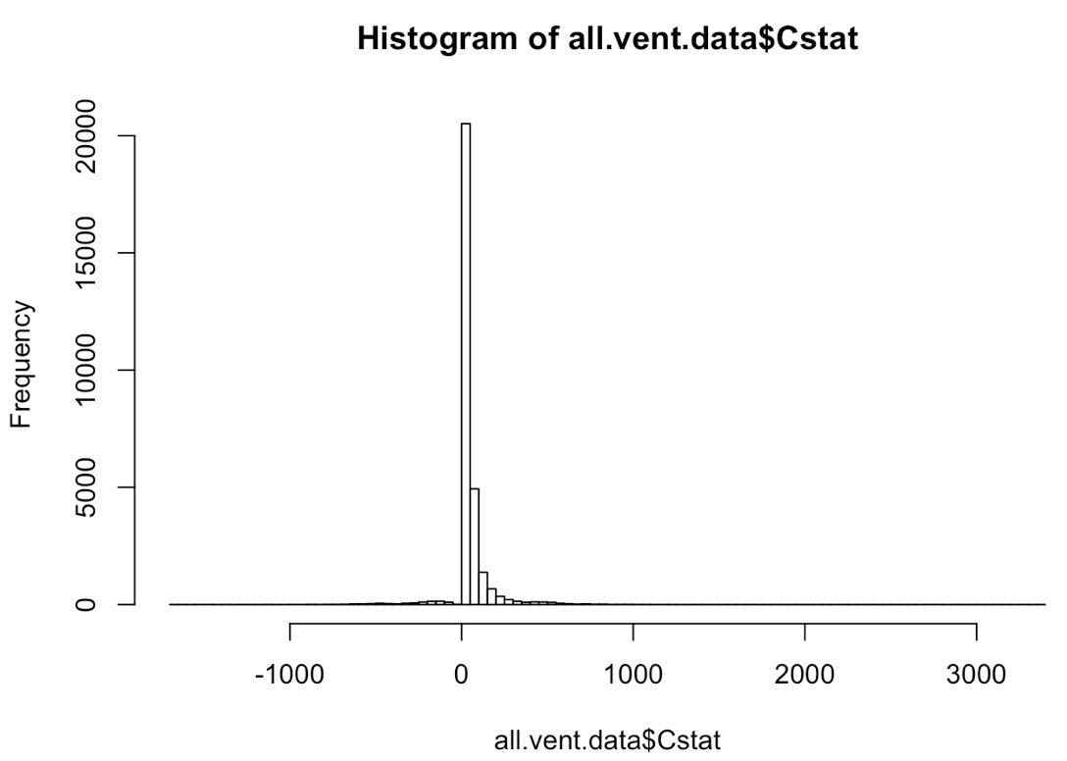

Slide 55
Interpret
Which rows are responsible for these bad values and can we inspect these data points?
bad_data <- which(all.vent.data$Cstat < 0)
all.vent.data[bad_data, ]
head (all.vent.data[bad_data, ], 15)

Slide 56
Clean
How can we go about cleaning these issues?

Slide 57
Annotation / Version Control
Use # to add comments to code
TIP: CTRL + SHIFT + C to comment out multiple lines simultaneously
GitHub
Markdown

Slide 58
R Markdown Document
Combination of R code and text
Can be used to write reports, presentations or interactive apps
Contains code, narrative, outputs and graphs

Slide 59
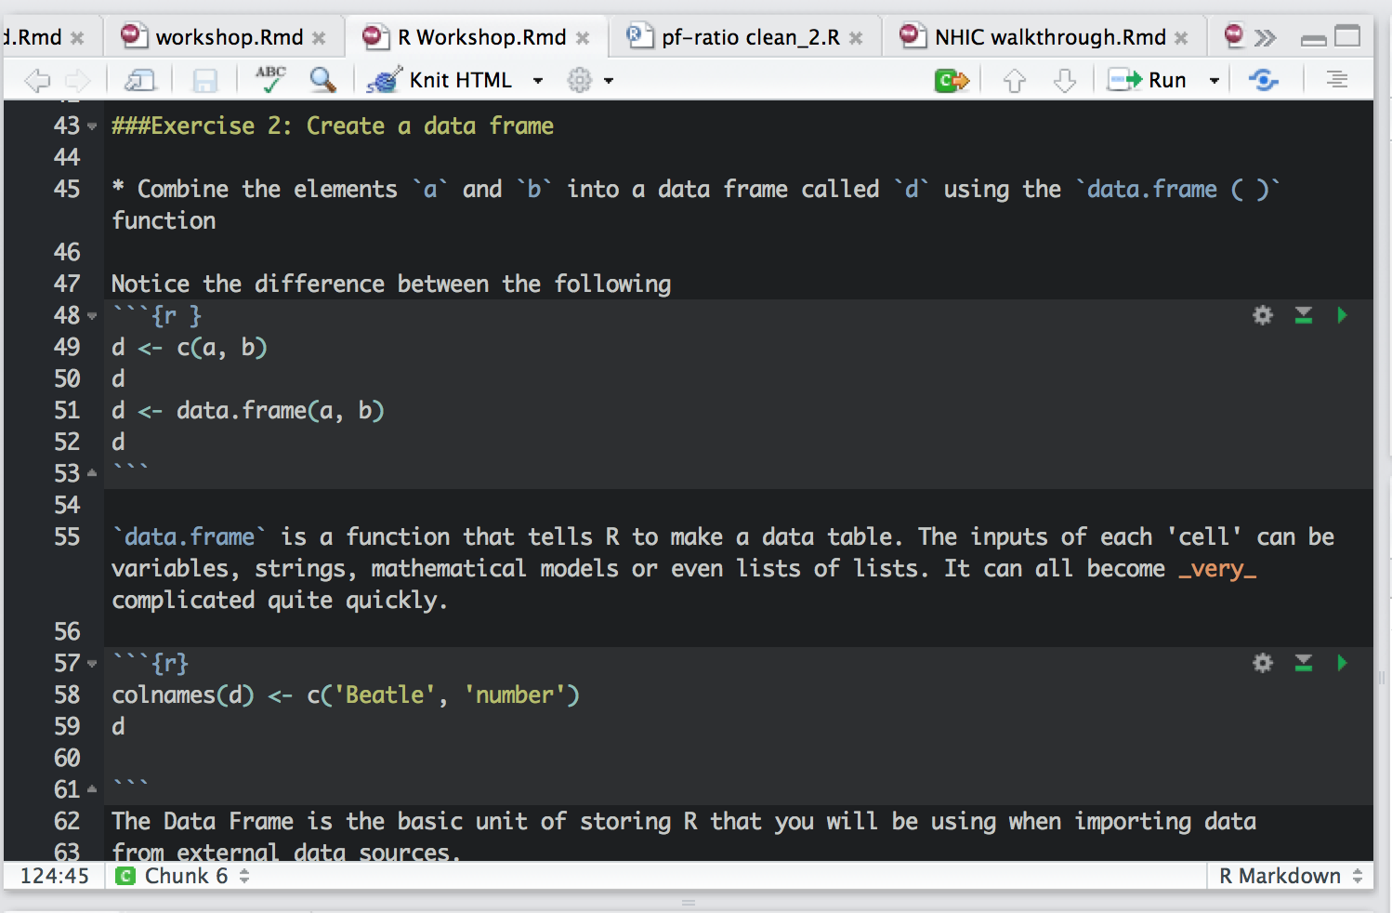

Slide 60
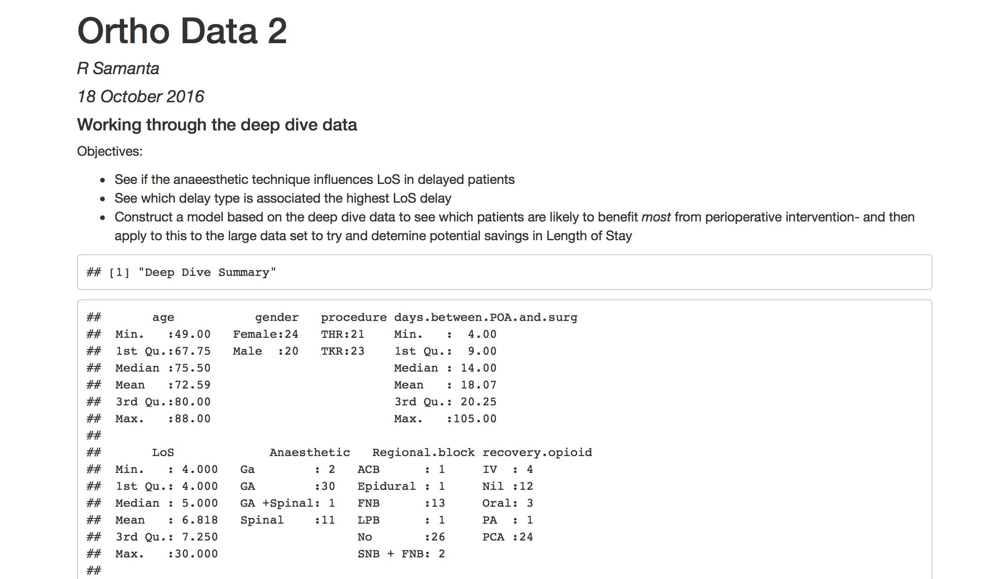

Slide 61
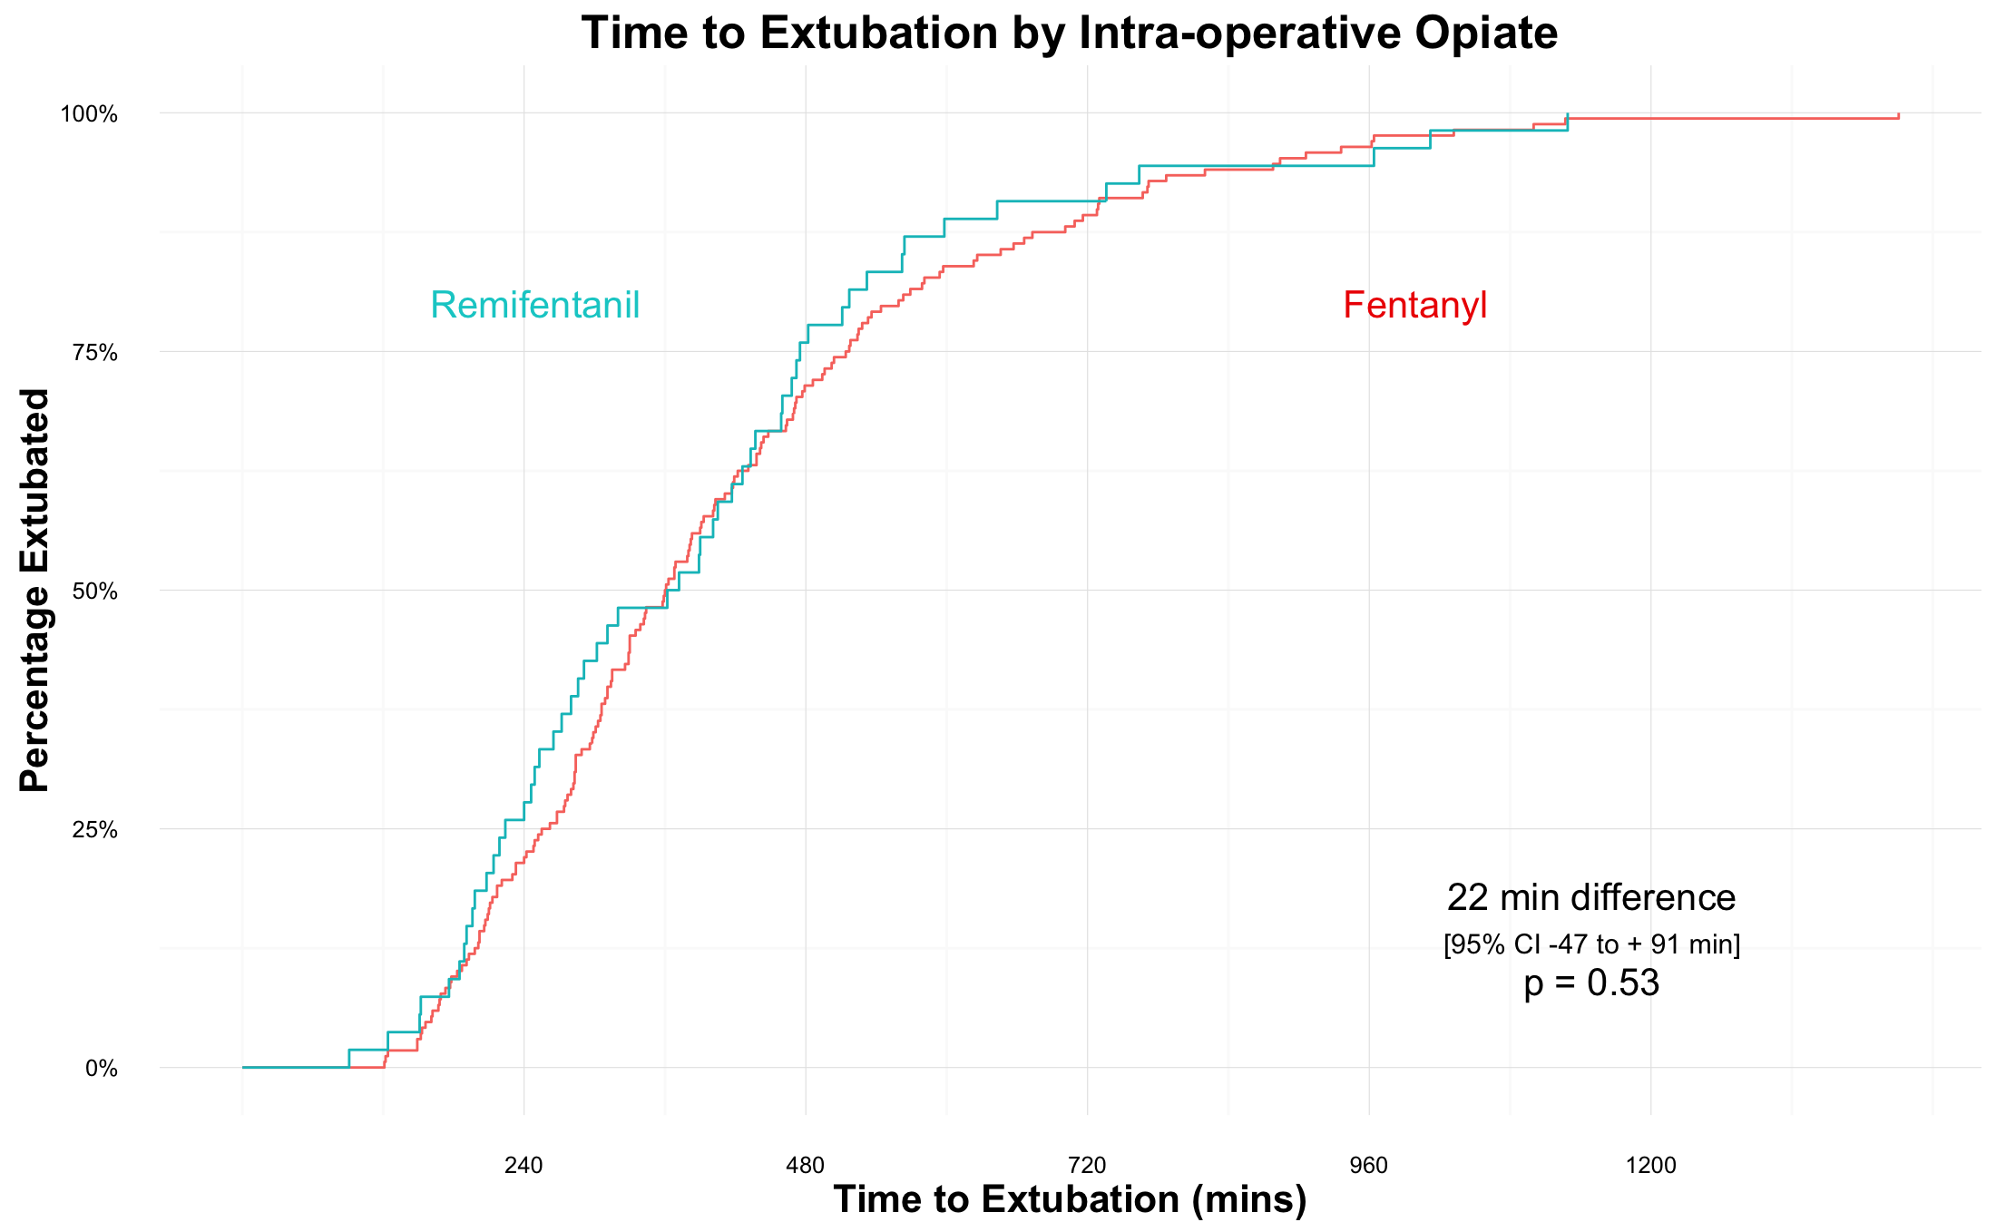

Slide 62
Results | Change in Creatinine
Sepsis
GI Surgery
Trauma

Slide 64
Thank you
Code School R course (free, very basic)
StackOverflow (for specific problems)
YouTube Hadley Wickham
Twitter #rstats @JennyBryan
Cambridge Bioinformatics training
All tutorial info and files available at:
https://github.com/dr-romster/Rtutorial
rs307@cam.ac.uk @dr_romster

Slide 65
Thank you
Code School R course (free, very basic)
StackOverflow (for specific problems)
YouTube Hadley Wickham
Twitter #rstats @JennyBryan
Cambridge Bioinformatics training
All tutorial info and files available at:
https://github.com/dr-romster/Rtutorial
rs307@cam.ac.uk @dr_romster

Slide 66
Exercise 5

Slide 67
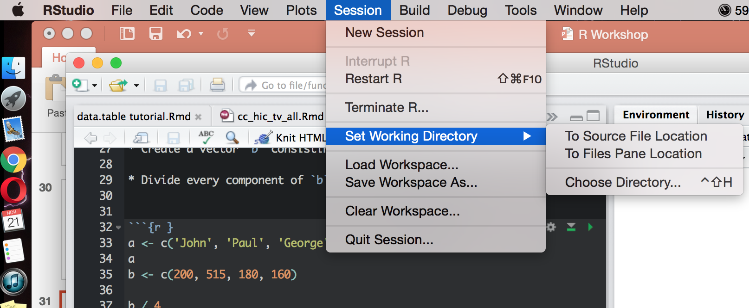
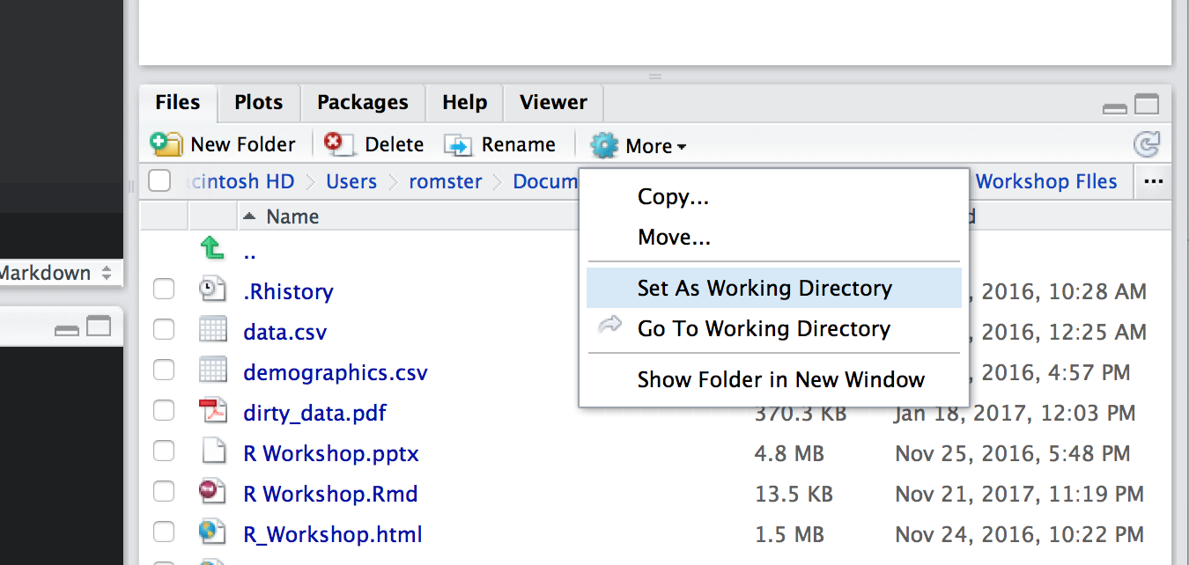
Set the working directory to the R Workshop folder on your Desktop
[ Session -> Set Working Directory ]

